Slide 1

Foundations for Compassion: Attentional Stability and Resting the Mind in its Natural State
Retreat by Palas Athena
May 9-11, 2014
Geshe Lobsang Tenzin Negi, Ph.D.
Director, Emory-Tibet Science Initiative
Spiritual Director, Drepung Loseling Monastery, Atlanta

Slide 2
Outline
What is compassion?
Benefits of compassion
Can we expand compassion?
Cognitively-Based Compassion Training:
a specific approach for developing compassion
Key Components of CBCT

Slide 3
What is Compassion?
The essence of compassion is a desire to alleviate
the suffering of others and to promote their well-being.
This is the spiritual principle from which all other positive inner values emerge.
–His Holiness the Dalai Lama, Beyond Religion
At a basic level, compassion (nying je) is understood mainly in terms of empathy–our ability to enter into and, to some extent, share others’ suffering.
–His Holiness the Dalai Lama, Ethics for the New Millennium

Slide 4
Benefits of Compassion
So the human capacity to care for others is not something trivial or something to be taken for granted. Rather, it is something we should cherish. Compassion is a marvel of human nature, a precious inner resource, and the foundation of our well-being and the harmony of our societies. If, therefore, we seek happiness for ourselves, we should practice compassion; and if we seek happiness for others, we should also practice compassion!
–H.H. the Dalai Lama, Beyond Religion

Slide 5
Benefits: Effects of CBCT on biochemical stress responses
TSST prior to
meditation training
TSST after
meditation training
0.5
0.5
IL-6
0
0
log plasma IL-6, pg/ml
log plasma IL-6, pg/ml
-0.5
-0.5
-1.0
-1.0
-1.5
0
15
30
45
60
75
90
-1.5
0
15
30
45
60
75
90
TSST
Time (min)
TSST
Time (min)
18
18
16
16
Cortisol
14
14
12
12
plasma cortisol, µg/ml
plasma cortisol, µg/ml
10
10
8
8
0
0
15
30
45
60
75
90
0
0
15
30
45
60
75
90
TSST
Time (min)
TSST
Time (min)
Pace et al. Psychoneuroendocrinol 2009;34:87-98;
Pace et al. Psychoneuroendocrinol 2010; 35: 310-15
low practice
high practice
Notes:
But we were still not able to say that these results were definitely caused by the compassion meditation. The reason is that the students only went through one TSST, after they had meditated, because many studies have been published showing that it is only possible to give a TSST one time and have the subject respond. And because we couldn’t give a TSST before meditation, we didn’t know how they would respond. It’s possible, in fact, that the way that a person responds to stress predicts whether or not they would be able to meditate. Maybe what we were seeing is that some people are more able to practice than other people. Maybe they’re calmer, and able to sit still longer, for example.
So we did a second study, with another group of freshmen that matched the first group. This time, they did the TSST first, and then they meditated. After the meditation class was over, we split them into low practice and high practice groups, and compared their performance on the TSST.
As you can see in the two graphs on the left, we found no differences between the groups that would predict who would later go on to practice the most. (The two graphs on the right are duplicates from the previous slides, placed here for comparison.)

Slide 6

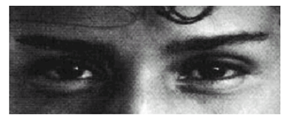
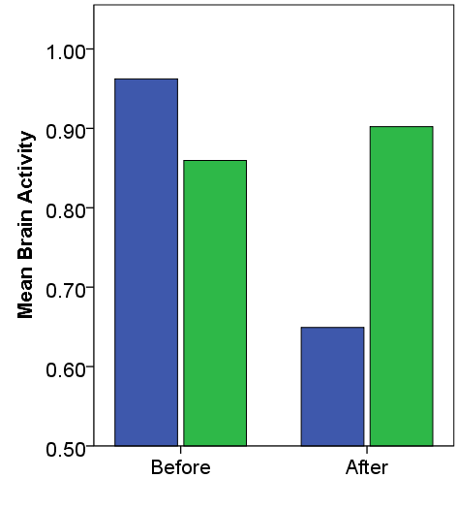
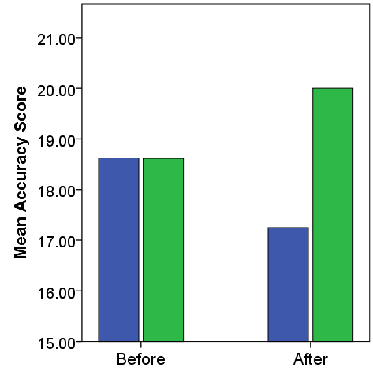
Benefits of Compassion Training: Empathic Accuracy
IFG Brain Activation and Reading the Mind in the Eyes
*
p < 0.05
*
p < 0.05
CBCT Group
Control Group
Mascaro et al. SCAN 2013; 8(1):48-55.

Slide 7
Can we expand compassion?
  “Generally I distinguish two levels of compassion. The first is the biological level I have been describing, exemplified by the affection of a mother for her newborn child. The second is an extended level, which has to be deliberately cultivated.”
  –His Holiness the Dalai Lama, Beyond Religion

Slide 8
Can we cultivate compassion?
  “As man advances in civilization, and small tribes are united into larger communities, the simplest reason will tell each individual that he ought to extend his social instincts and sympathies to all the member of the same nation, though personally unknown to him. This point being, once reached, there is only an artificial barrier to prevent his sympathies extending to the men of all nations and races… Sympathy beyond the confines of man, that is, humanity to lower animals, seems to be one of the latest moral acquisitions. This virtue, one of the noblest with which man is endowed, seems to arise incidentally from our sympathies becoming more tender and more widely diffused, until they are extended to all sentient beings.”
  –Charles Darwin, The Descent of Man

Slide 9
  Methods for developing Compassion: A standard Buddhist framework for developing positive emotions
View, Behavior and Meditation
  View: dependent origination
  Behavior: non-violence and compassion
  Meditative training: stabilizing and analytical (cognitive) meditations
  “I believe strongly that there is an intimate connection between one’s conceptual understanding of the world, one’s vision of human existence and its potential, and the ethical values that guide one’s behavior. How we view ourselves and the world around us cannot help but affect our attitudes and our relations with our fellow beings and the world we live in. This is in essence a question of ethics.”
  –His Holiness the Dalai Lama, Universe in a Single Atom

Slide 10
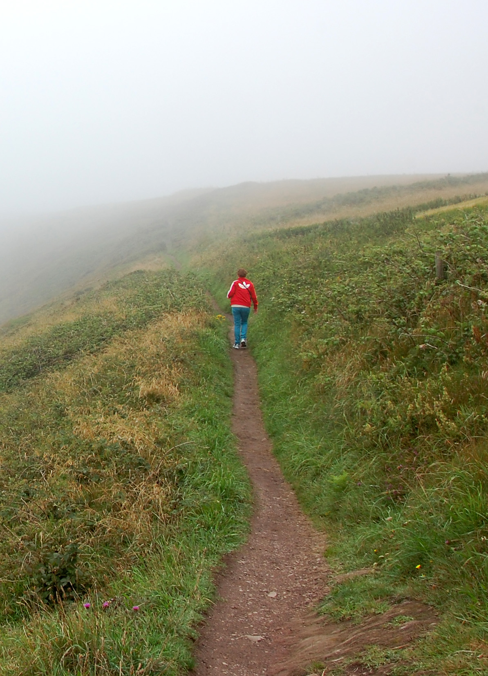
  Methods for developing Compassion:
  A standard Buddhist framework for developing positive emotions
By fine-tuning our understanding or view to better accord with reality, we can alter our affective and behavioral responses.
This new understanding must become deeply engrained through immersive meditative training.

Slide 11
Cognitively-Based Compassion Training:
A specific approach for developing compassion
Cognitively-Based Compassion Training (CBCT) is drawn from the lojong (training the mind) and lam rim (stages of the path) traditions of Tibetan Buddhism, but rendered into secular form. It was developed as a protocol for research on compassion training at Emory University.
Of the two styles of meditation presented in these traditions, che-gom (analytical or cognitive) and jog-gom (stabilizing meditation), CBCT primarily employs the former.
CBCT recognizes a biologically-given potential for compassion in all of us, but employs deliberate training to expand this capacity beyond the limits of in-group/out-group bias.

Slide 12
“ A human being is part of the whole called by us universe, a part limited in time and space. We experience ourselves, our thoughts and feelings, as something separate from the rest. A kind of optical delusion of consciousness. This delusion is a kind of prison for us, restricting us to our personal desires and to affection for a few persons nearest to us. Our task must be to free ourselves from the prison by widening our circle of compassion to embrace all living creatures and the whole of nature in its beauty. The true value of a human being is determined by the measure and the sense in which they have obtained liberation from the self. We shall require a substantially new manner of thinking if humanity is to survive”.
–Albert Einstein

Slide 13
Key components of CBCT
Developing Attentional Stability
Resting the Mind in its Natural State
Self-Compassion
Developing Impartiality
Developing Affectionate Love and Empathy
Strengthening Compassion

Slide 14
What is Shamatha, or calm abiding?
Calm abiding is a mental state that has pacified distractions to external objects and attends continuously and spontaneously to an inner meditative object, and which is endowed with joy and pliancy.
- Kamalashila’s Bhavanakrama
Notes:
(CLICK)

Slide 15

Why cultivate Shamatha?
“Thus having trained in joyous effort,
Place your mind in meditative stabilization.
For a person with a distracted mind
Abides between the fangs of the afflictions.” - Shantideva
Notes:
(CLICK)

Slide 16
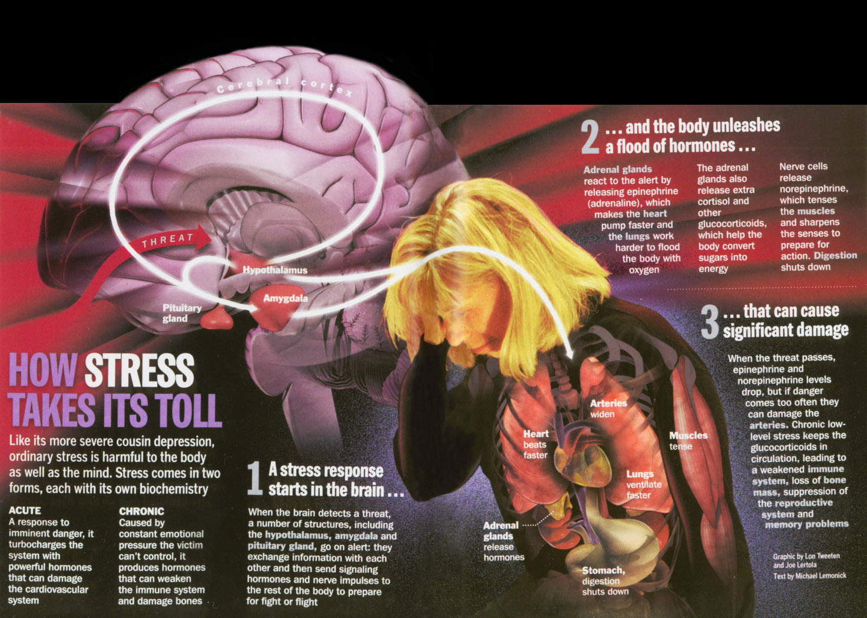
Disadvantages of Chronic Stress
Notes:
Hypothalamus controls the fight or flight response.
This response did have evolutionary significance.
The sympathetic nervous system becomes highly active.
Part of the involuntary nervous system.
The involuntary, or autonomic, nervous system deals with the everyday bodily functions
Normally do not come into consciousness,
Maintenance of heartbeat and blood pressure, regular breathing, and digestion.
The body secretes adrenalin and noradrenalin. These hormones and their related substances bring about the physiologic changes in the body.
(CLICK)

Slide 17
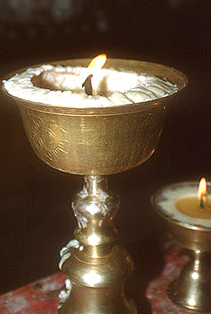
Putting Shamatha in Context
“With insight alone, divorced from calm abiding, the yogi’s attention will become distracted to objects. Like a butter lamp that is located in a draft, it will not become stable. As such, the vivid appearance of wisdom will not arise. Therefore, you should apply yourself to both equally.”
Kamalashila’s Bhavanakrama
Notes:
(CLICK)

Slide 18
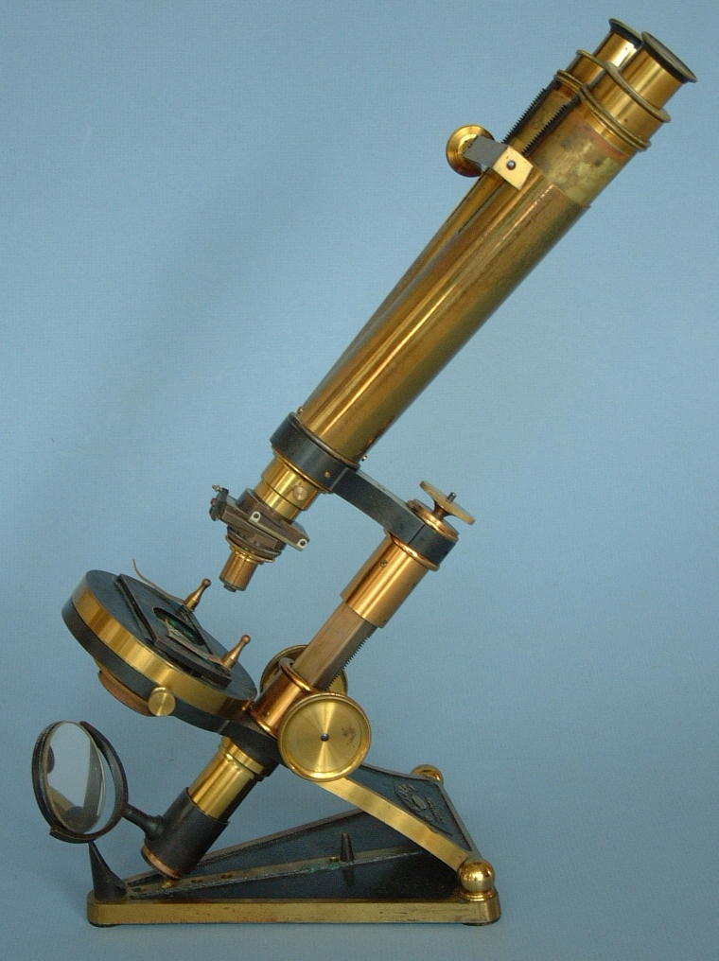
Putting Shamatha in Context
Samadhi
Meditative stabilization
• Clarity
• Stability

Slide 19
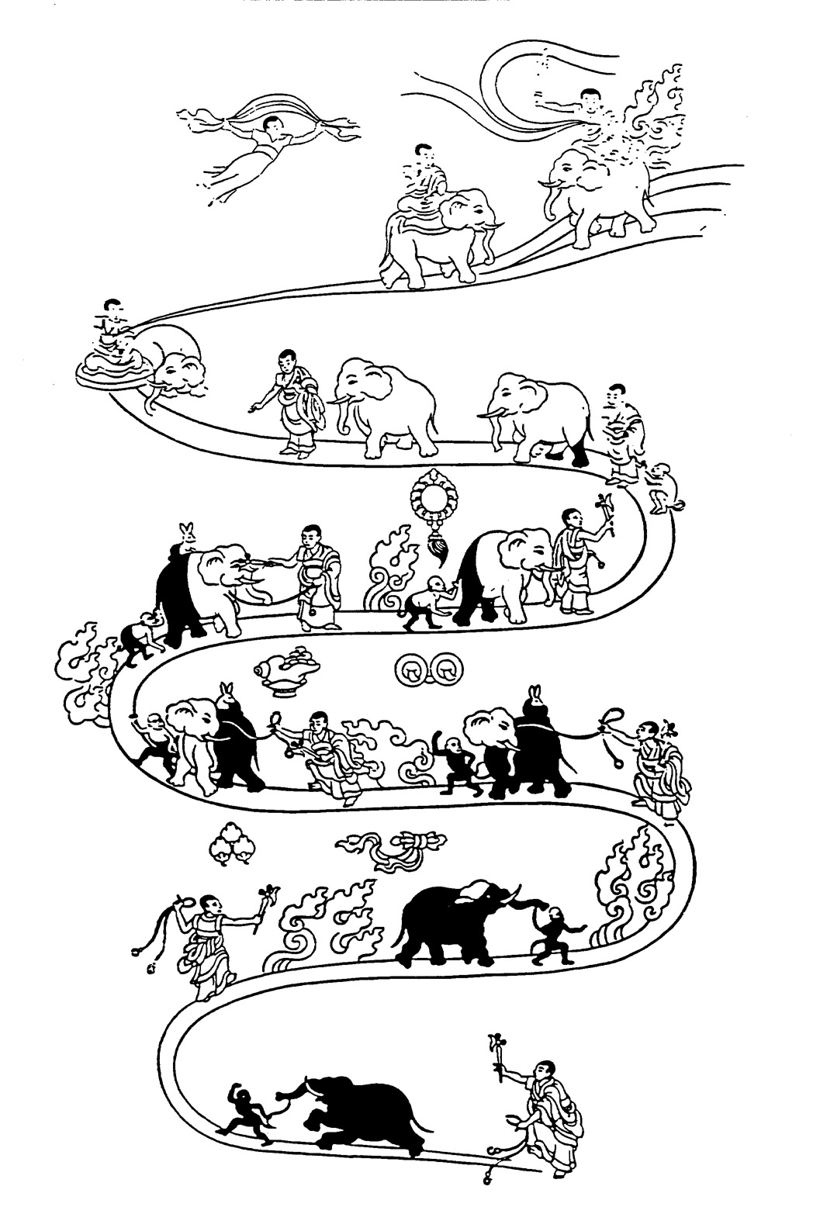
The Process of Cultivating Shamatha
Causal Collections for
Developiang Calm Abiding
The physical postures for
meditation
The Eight Remedies to
the Five Obstacles for
Shamatha
The Nine Mental Abidings
Notes:
(CLICK)

Slide 20
Causal Collections for Developing Calm Abiding
Suitable place
Lessening desires
Having contentment
Giving up unrelated activities
Maintaining pure morality
Abandoning disturbing conceptions
Notes:
(CLICK)

Slide 21
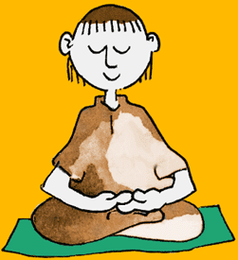
Meditation Posture
The Seven Features of Vairocana Buddha:
Cross-legged
Spine straight like an arrow
Hands in meditation posture
Shoulders level
Head slightly bent forward
Eyes cast down
Lips and teeth in natural position
Notes:
(CLICK)

Slide 22
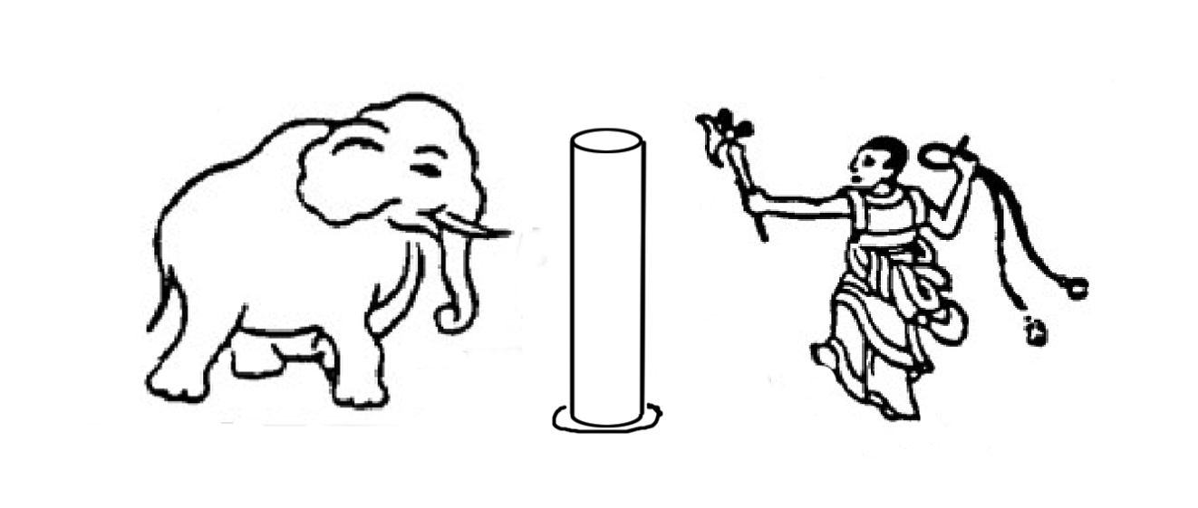
To Train the Elephant
Essential Tools for Taming Elephant Mind
To Train the Mind
Pillar
Rope
Attentive Trainer/hook
Object of Attention (Breath)
Mindfulness
Introspective vigilance
”The unruly elephant of your mind
Is securely bound by the rope of mindfulness
To the firm pillar of the object of attention,
And is gradually controlled with the hook of vigilance.”
Notes:
Relaxation response not unique to TM. Can be obtained through any kind of concentration meditation.
Single-pointed concentration is most basic and universal of all meditation practices, found in every spiritual tradition that employs meditation.
Cultivating concentration is the beginning, a pre-requisite for moving on to more intricate approaches.
Concentration is most generic form of mind training, with many non-spiritual applications.
Process of taming elephant provides a model for curbing the unhealthy reactions of our mind and attitudes.
(CLICK)

Slide 23
The Eight Remedies to the Five Obstacles for Shamatha
Obstacles
Laziness
Forgetfulness
Mental sinking & excitement
Non-application
Overapplication
Remedies
Faith
Aspiration
Effort
Pliancy
Mindfulness
Introspective vigilance
Application
Non-application / Equilibrium
Notes:
(CLICK)

Slide 24
The Nine Mental Abidings
Placing the Mind
Continual Placement
Re-placement
Close Placement
Controlling
Pacifying
Completely Pacifying
Single-pointedness
Placement in Equipoise
Notes:
(CLICK)

Slide 25

Putting Vipashyana in Context
Shila - moral discipline
Samadhi - meditative stabilization
Prajna - Wisdom
“Abiding in moral discipline, meditative stabilization is obtained.
Having obtained meditative stabilization, one must cultivate wisdom.”
- The Buddha
Notes:
25
(CLICK)

Slide 26
What is Vipashyana, or special Insight?
That which properly examines suchness from within a state of calm abiding is special insight. The Cloud of Jewels Sutra reads, “Calm abiding meditation is a single pointed mind; special insight makes specific analysis of the ultimate.”
- Kamalashila’s Bhavanakrama
Notes:
(CLICK)

Slide 27
Significance of Vipashyana
“Mere calm abiding meditation cannot deliver pure awareness, nor can it eliminate the darkness of obscurations. If wisdom properly acquaints itself with reality, awareness will become pure. Only wisdom understanding reality can effectively eradicate obscuration.”
- Kamalashila, Bhavanakrama
Notes:
(CLICK)

Slide 28
Vipashayana and the Four
Applications of Mindfulness
Mindfulness of body
Mindfulness of feelings
Mindfulness of mental states and processes
Mindfulness of phenomena
“Having cultivated calm abiding meditate on the application of
the (four) mindfulness by analyzing the two fold
characteristics of the body feelings, mind and phenomena.”
-Vasubandhu, Abhidharmakosha

Slide 29
Etymology of the Application of Mindfulness
“The etymology of the application of mindfulness is:
closely maintaining mindfulness on an object that is discerned by a discriminating awareness.”
-Asanga, Abhidharmasamuccaya

Slide 30
The Particular Characteristics of Body,
Feelings, Mind, and Phenomena
1. A conditioned body is imperfect.
2. A conditioned sensation is unsatisfactory.
3. The primary mind and mental process are transitory.
4. Wholesome phenomena are objects to be cultivated and unwholesome phenomena are objects to be abandoned.
“In order to engage in the practice of the Four Noble Truths, and the insights into the faults, the causes of desire, clarity and peace, one should meditate on the four applications of mindfulness.”
-Maitreya, Madhyantavibhaga

Slide 31
Three General Characteristics of Body, Feelings, Mind, and Phenomena
Impermanence
Unsatisfactoriness
Emptiness and selflessness
“All created things are impermanent.
When you perceive this with true insight, then you become detached from suffering; this is the path of purification.”
-The Buddha
Notes:
(CLICK)

Slide 32
The Six Similes / Methods for Placing the Mind on its Object of Focus
Placing the mind like a sun unobstructed by clouds
Placing the mind like an eagle gliding in the sky
Placing the mind like a ship on the great ocean
Placing the mind like a child looking at a mural in
a temple
Placing the mind like a sparrow flying through the
sky without leaving a trace
Placing the mind like a matted piece of wool.
Notes:
(CLICK)

Slide 33

The Beginner’s Mind
Innocence
Non-judgmental
Openness
Notes:
Trainer also needs proper attitude for training elephant.
(CLICK)

Slide 34

Ripples on the Surface
Equanimity:
Rejecting Nothing,
Pursuing Nothing
Acceptance
Forgiveness
Notes:
(CLICK)

Slide 35

Flight of the Eagle
Spaciousness
Effortlessness
Spontaneity
Graceful
Notes:
(CLICK)

